Slide 1
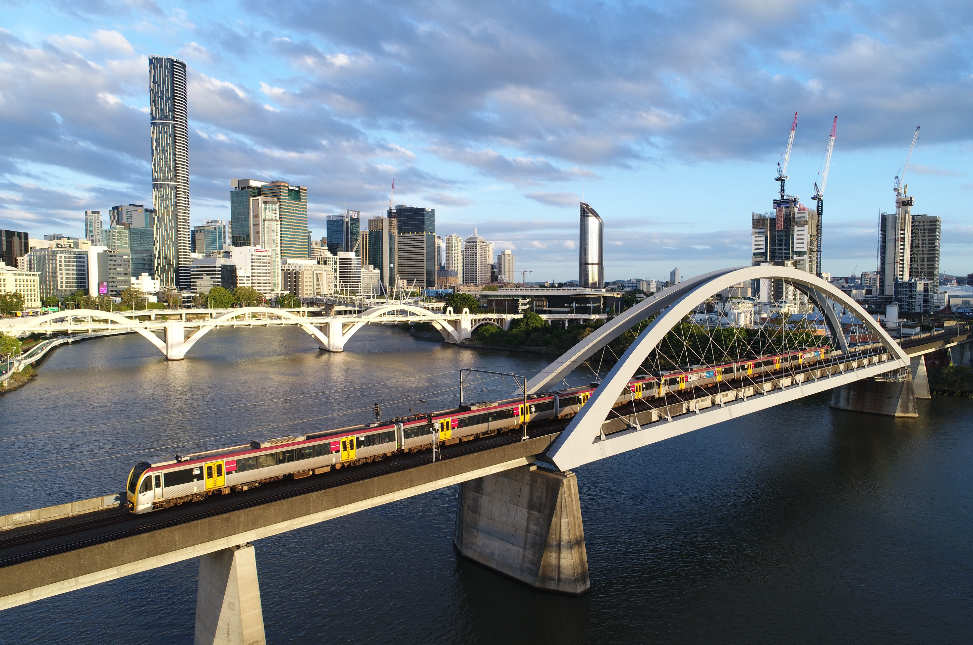

Company Profile
October 2023

Slide 2
01.
ABOUT US
Local Australian Company
JETRANSIT is a local fully Australian company providing the bridge between People, Transport and Technology with expertise in the integration of local content and the best cost, quality solutions.
JETRANSIT brings together Transport and Technology developed by our Customers and partners and provides an interface to the public.
These interfaces have grown from the surfaces we sit on, beside or below, to everything we interact with including passenger information technology, passageways, catering facilities and more.
02.
Global Sourcing Capabilities
03.
Strong Project Integration Experience
04.
Proven Delivery Performance

Slide 3
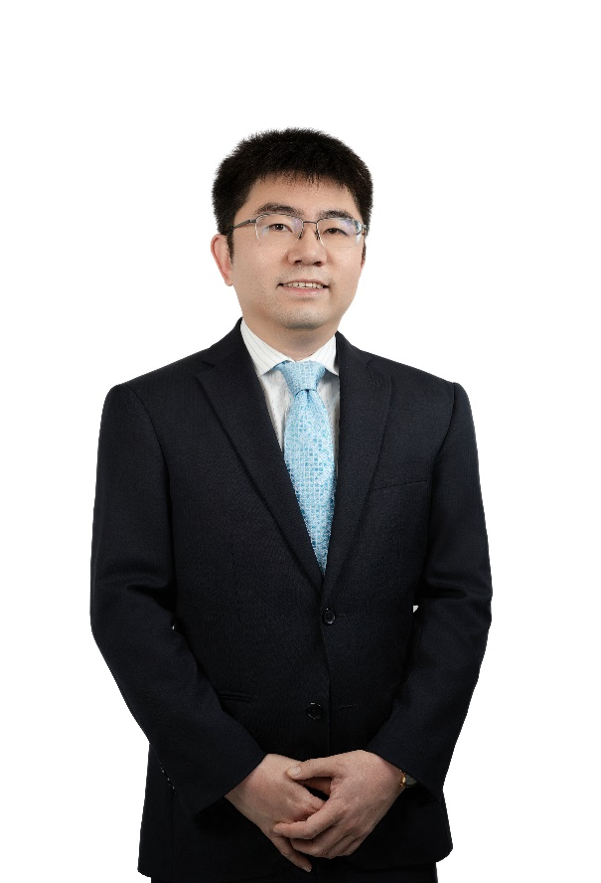


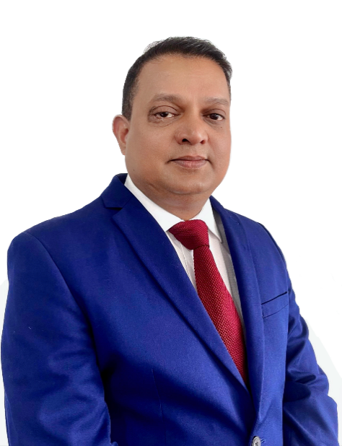


OUR TEAM
A team of experienced Rail Integrators with well-established connections within the Australian Rail Network and also into Chinese high speed rail supply chains.
Fan Jiang
Kevin McCarthy
Managing Director with 15+Years experience in Business Development in AEPC and Strong connect in Rail industry in China
Chief Executive Officer with over 35 year experience as an Australian rail industry executive
Simon Qi
Shawn Matthews
Richard Hudson
Chen Li
International Supply Chain management expertise
Business Development & Operations Manager with electronic control systems expertise in the rail industry
Project Manager with aircraft Industry and GRP /plastics material expertise
Senior Project Engineer with experienced in mechanical Engineering in both Aviation and Rail Industry

Slide 4
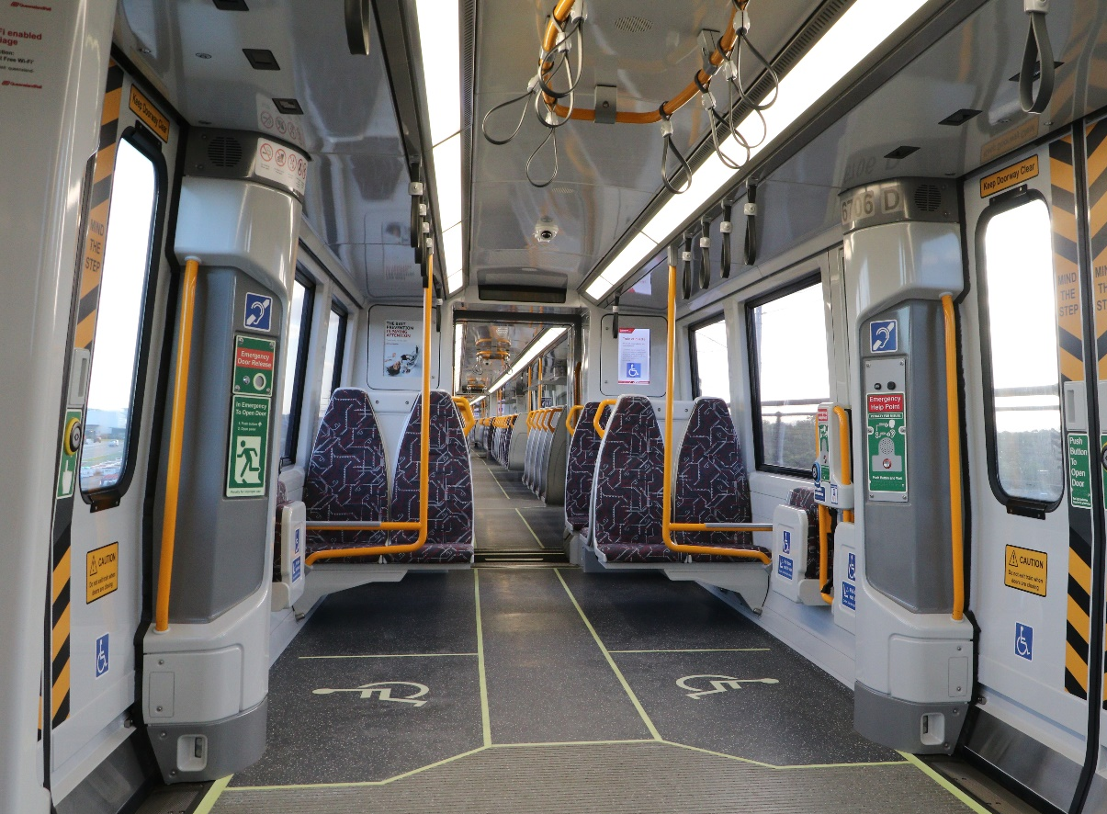
OUR SERVICES
JETRANSIT is Australian owned and operated with focus on rail transport vehicle components and subsystems, specializing in the integration of delivery streams bringing low cost overseas content together with local content to deliver best value solutions meeting local compliance. Our team has significant rail industry experience and connections in both Australia and China.
01. Design Services
02. Asset Management Services
03. Through-life Maintenance
04. Low-Cost Manufacturing
05. Delivery, including JIT
4
06. Installation Services

Slide 5
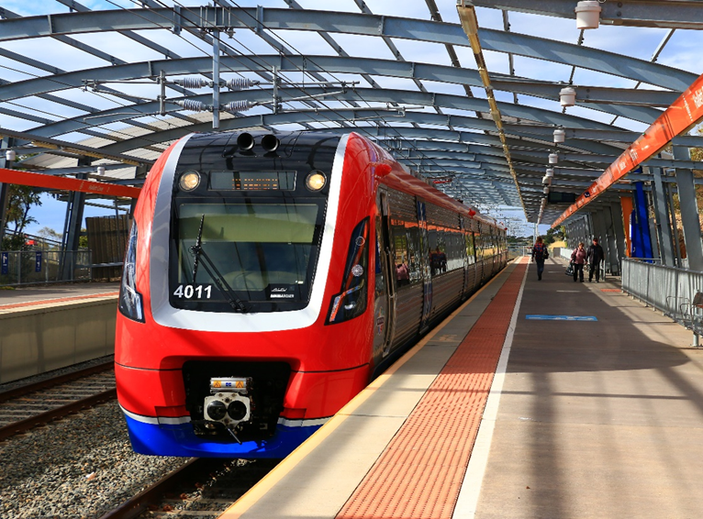
CUSTOMER VALUE
01
02
03
04
Optimised Transport Solutions
Low-Cost Parts
Local Content
Best Value
JETRANSIT’s expertise is the integration of complex delivery streams to achieve local compliance
JETRANST sources parts from a select group of China’s high speed rail component manufacturers, bringing high-quality low-cost content into Australia.
JETRANSIT’s mgmt. understands the local environment and local state-by-state solutions with facilities in Melbourne, Sydney and Brisbane ready to deliver local content requirements.
Low Cost and Local Content are sometimes can optimize andirectly competing demands. JETRANSIT intelligent mix to deliver all customer requirements.
5

Slide 6

CURRENT & PREVIOUS
PROJECTS
NSW NIF
VIC LRV
VIC VLOCITY
WAPTA
QR IMU & SMU
VIC HCMT
SYDNEY METRO
VIC X’TRAPOLIS
ADELAIDE EMU
Supply into most Australian states
Large range of products.

Slide 7

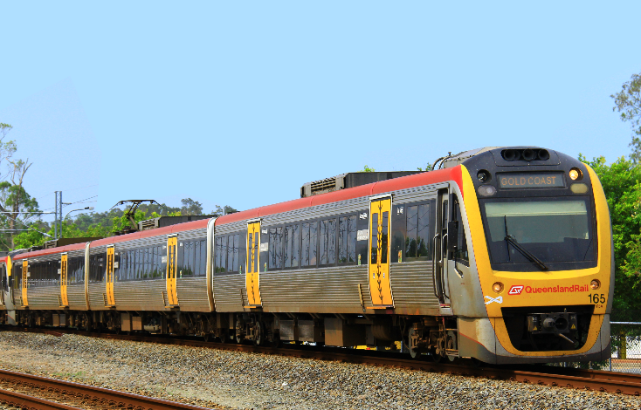
CCTV,COMMS,DAS, SDI& MCP
QR older emu’s (case Study #1)
68 sets of 3 cars, Full train information system, delivered 2021 – 2023
01. Design Services Full design & RPEQ support, prototyping, latest technology CAT 7 network solution, driver acceptance
02. Asset Management Services Large range of products available
03. Through-life Maintenance Spare parts supply, customer service variations for integration across other projects
04. Low-Cost Manufacturing China manufacture, support for document deliverables & acceptance
05. Delivery, including JIT Local warehousing and LRU testing in prep for installation
7
06. Installation Services Local installation team working at QR running depot with special licences and safety processes

Slide 8
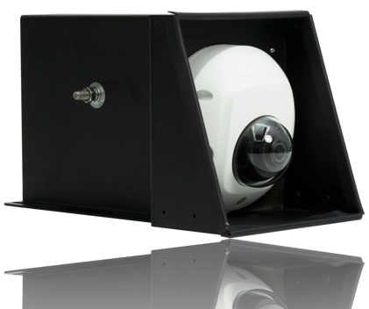
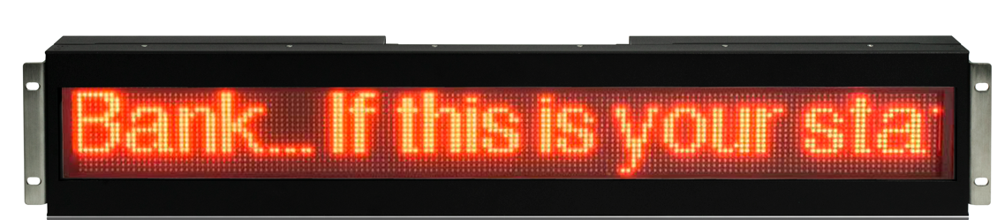

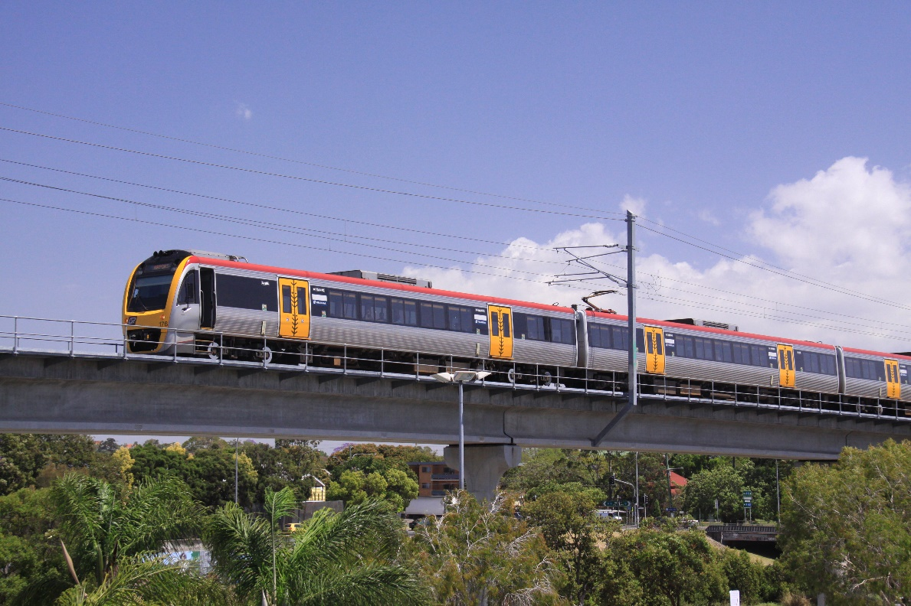
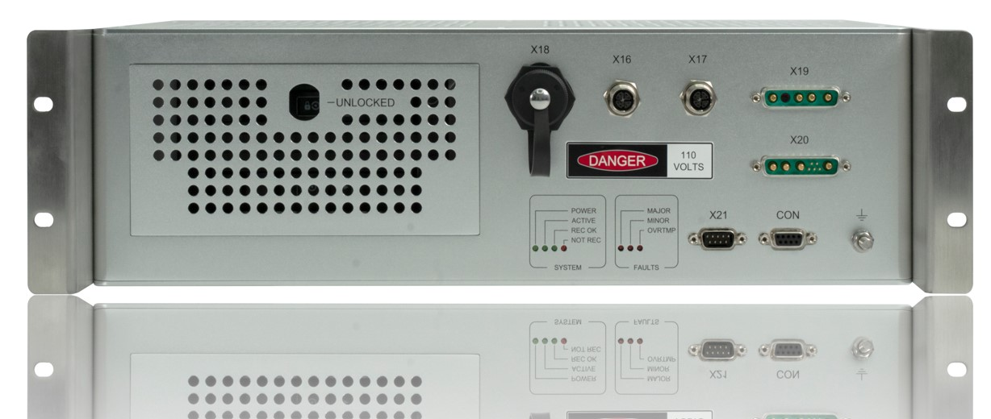
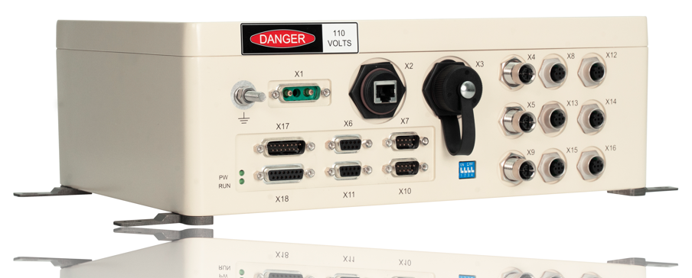
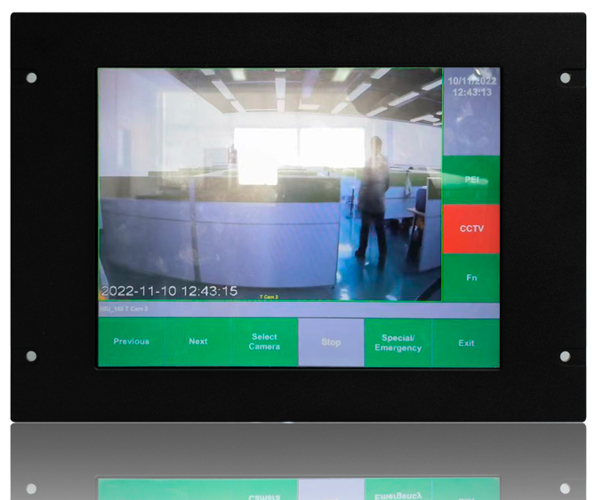
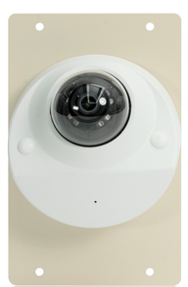
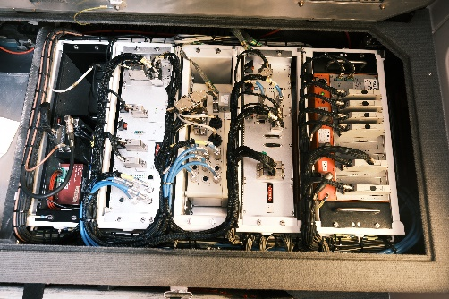
CCTV,
COMMS,
DAS, SDI
& MCP
(case Study #1)
8

Slide 9
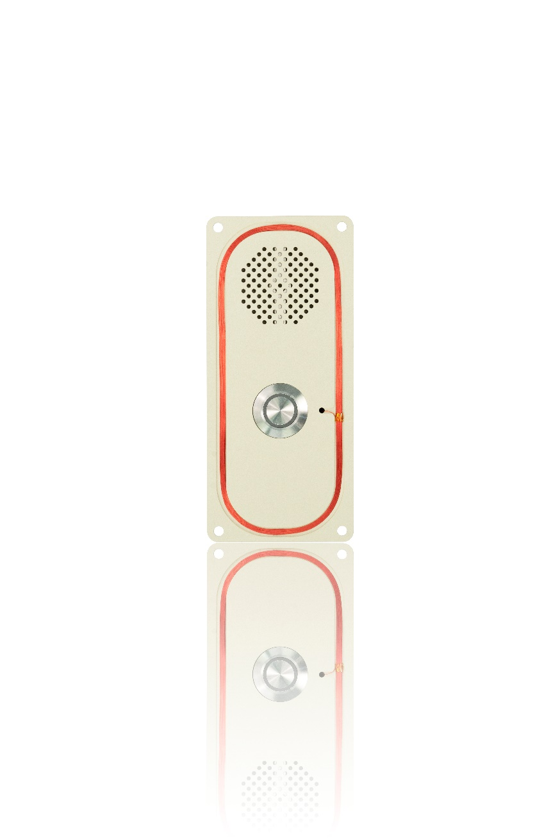
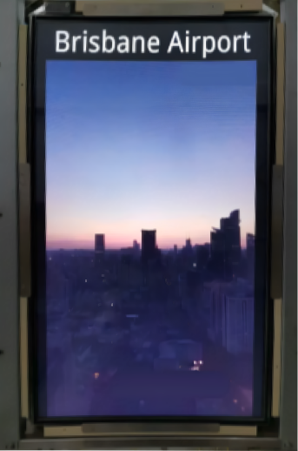
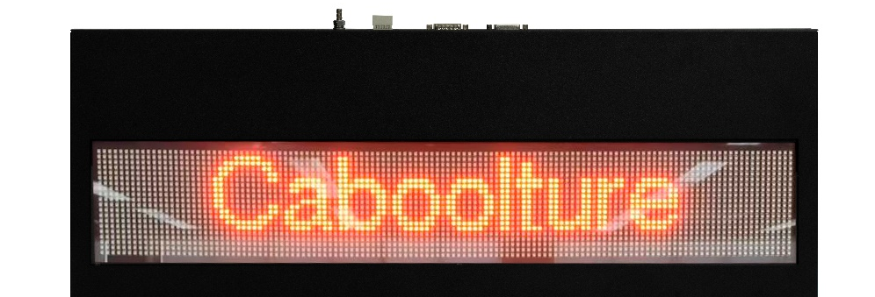
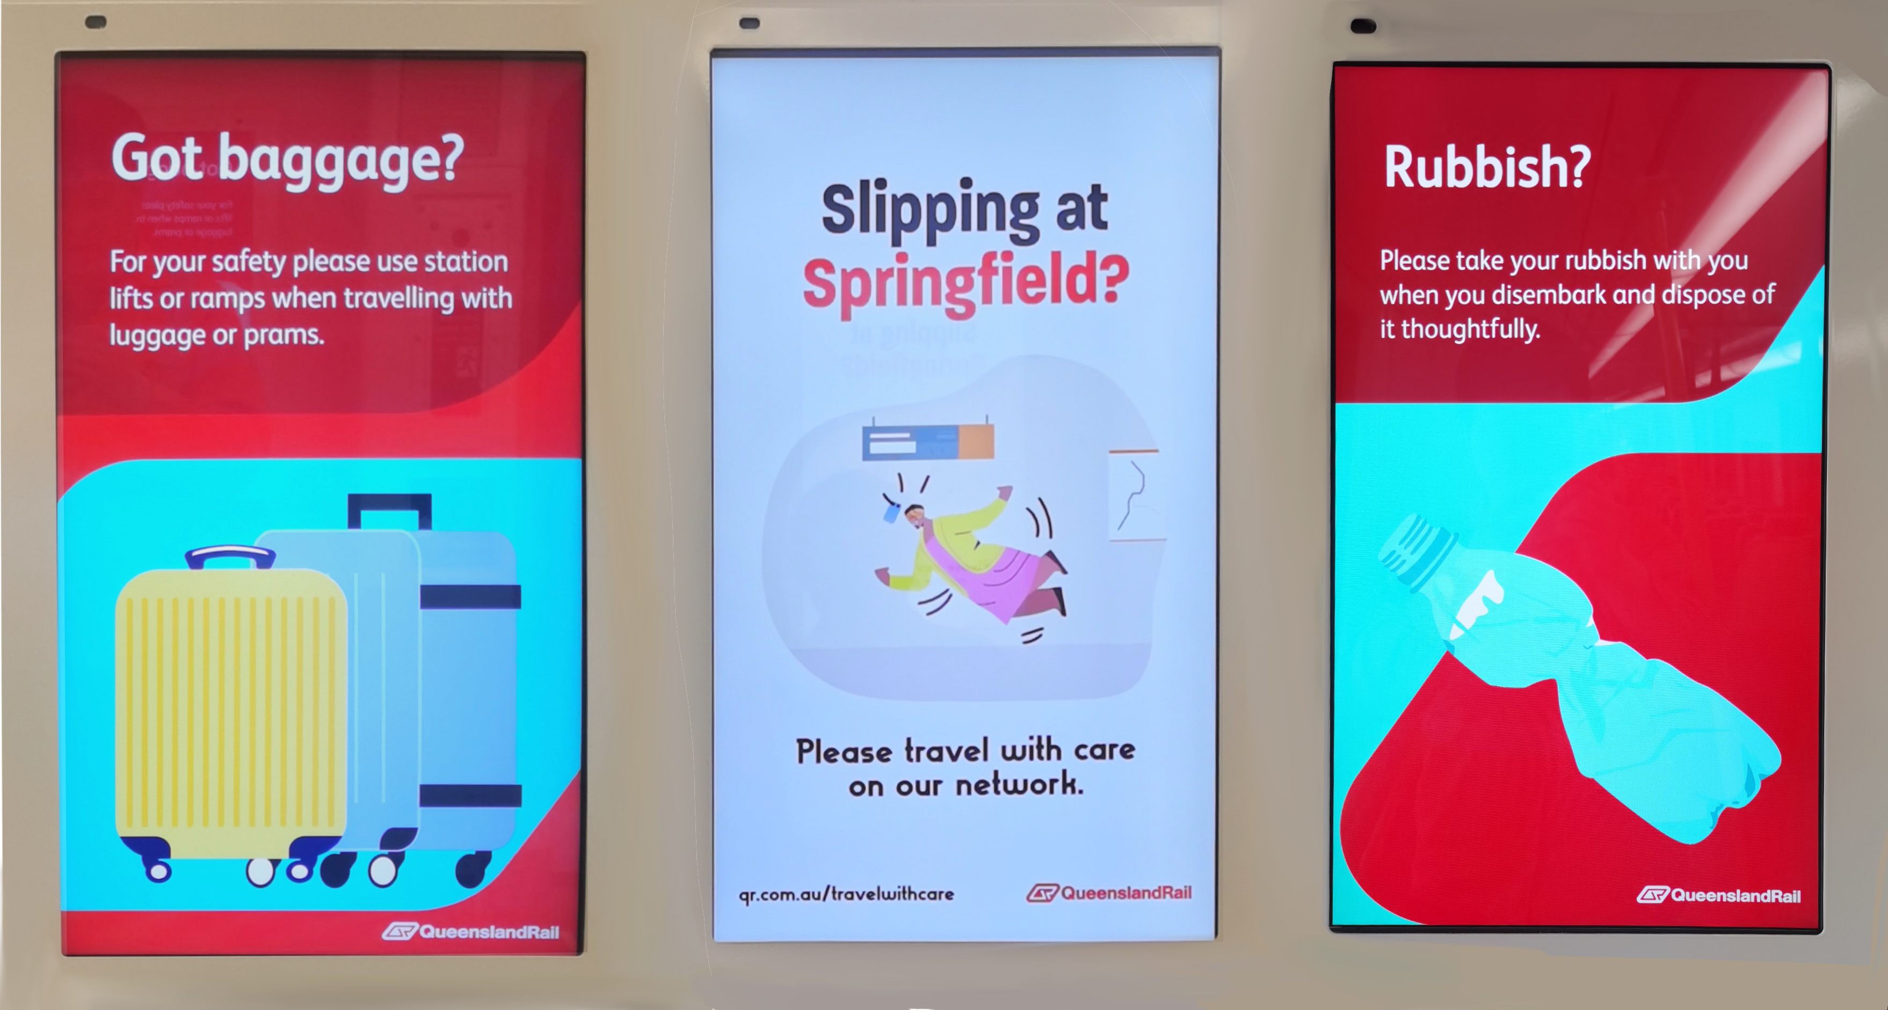
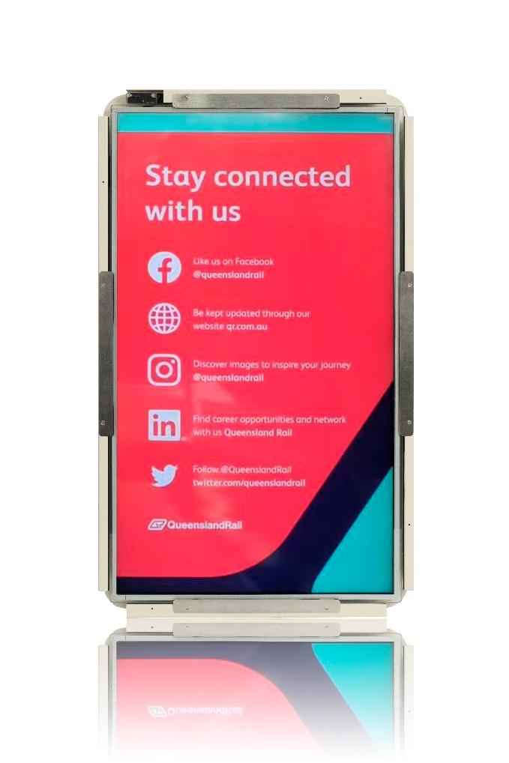
CCTV,
COMMS,
DAS, SDI
& MCP
(case Study #1)
9

Slide 10
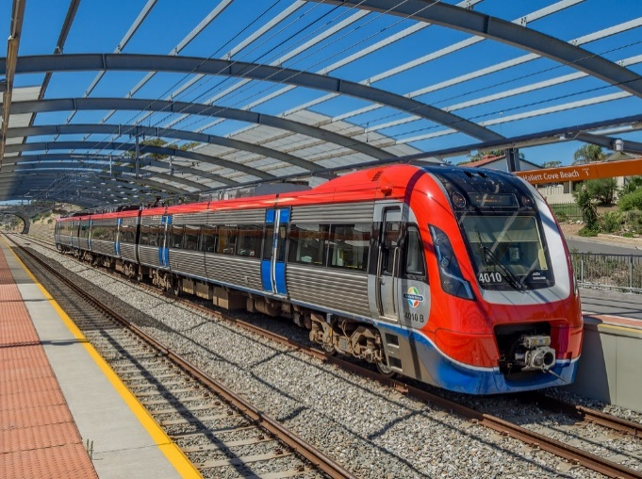
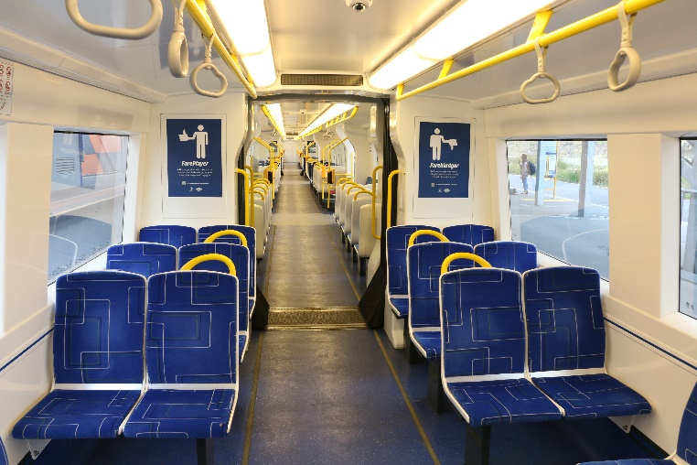
INTERIORS & EXTERIOR SURFACES
Adelaide EMU (case Study #2)
12 Sets Of 3 Cars, Full Interior Alu & Exterior Grp, Delivered 2019 – 2023
01. Design Services
02. Through-life Maintenance
03. Low-Cost Manufacturing
04. Delivery, including JIT
Re-design of ceiling to lower manufacturing cost.
Design nosecone for impact compliance, fiberglass prepreg composites
Spare parts supply
China manufacture, support for type testing, FAI, Quality ITP’s & Quality improvement plans
Local warehousing for JIT deliveries to train build line
10

Slide 11
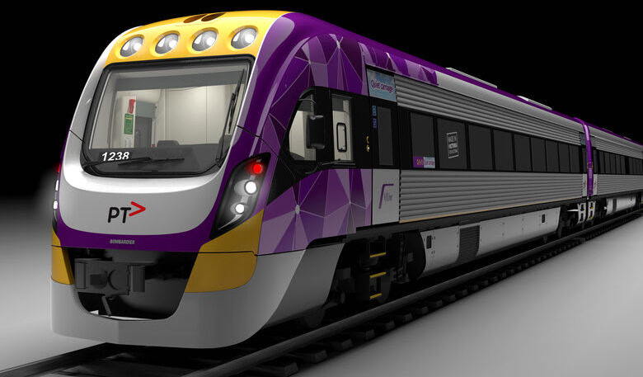
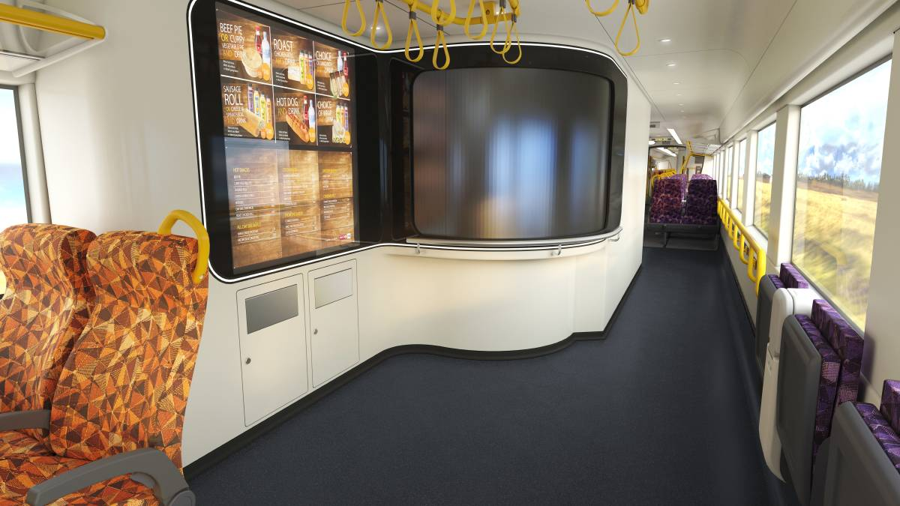
INTEGRATED GALLEY SYSTEM
V’locity dMU (case Study #3)
6 sets of 3 cars, Full galley kitchen, delivered 2021 – 2023
01. Design Services Full design, disability & human factors, crashworthiness & aesthetics, unique door requirements
02. Through-life Maintenance Spare parts supply, customer in-service variations
03. Low-Cost Manufacturing China manufacture, support for type testing, FAI, quality ITP’s
04. Delivery, including JIT Local team on train build site for module assembly and JIT handover
05. Installation Services Technical assistance to train builder
11

Slide 12
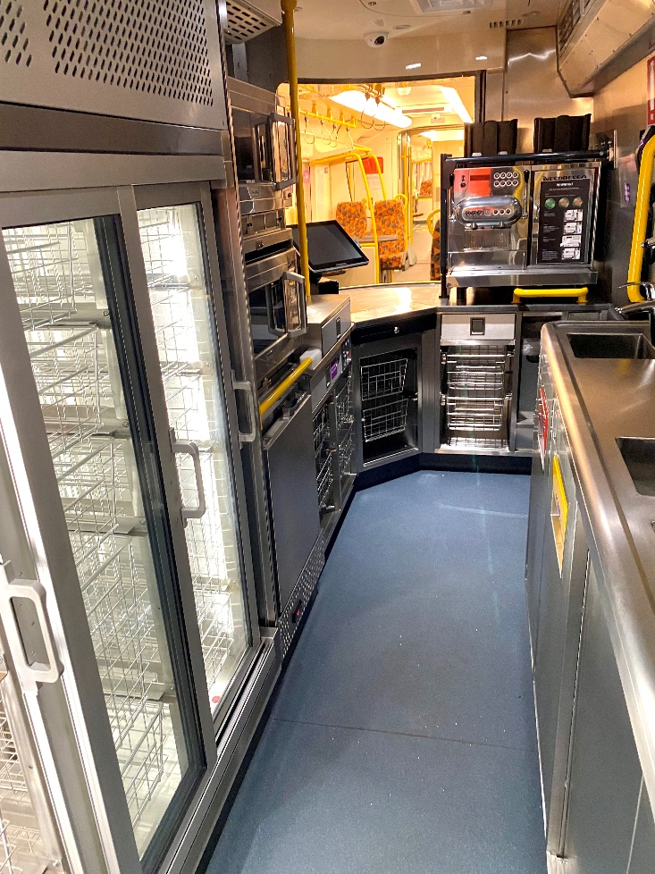
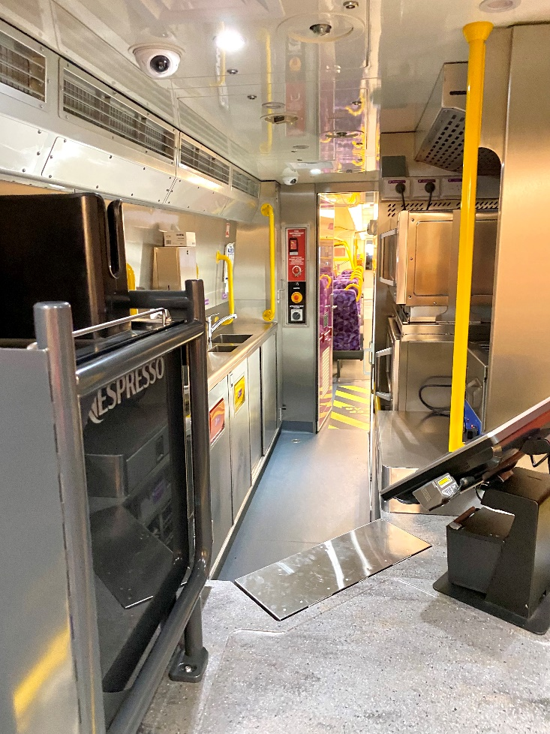
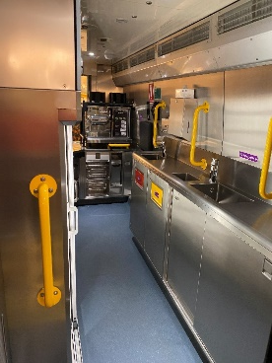
INTEGRATED GALLEY
SYSTEM
(case Study #3)
12

Slide 13
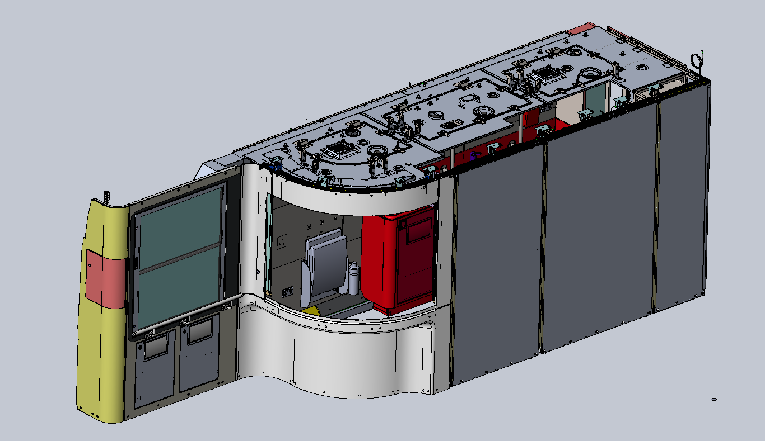
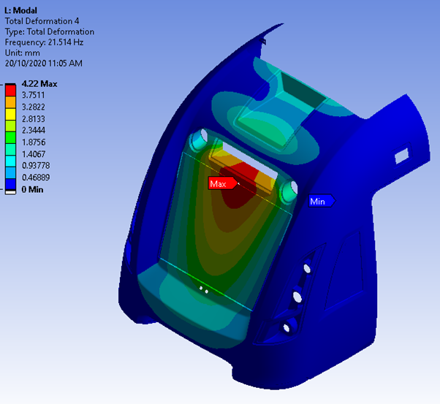
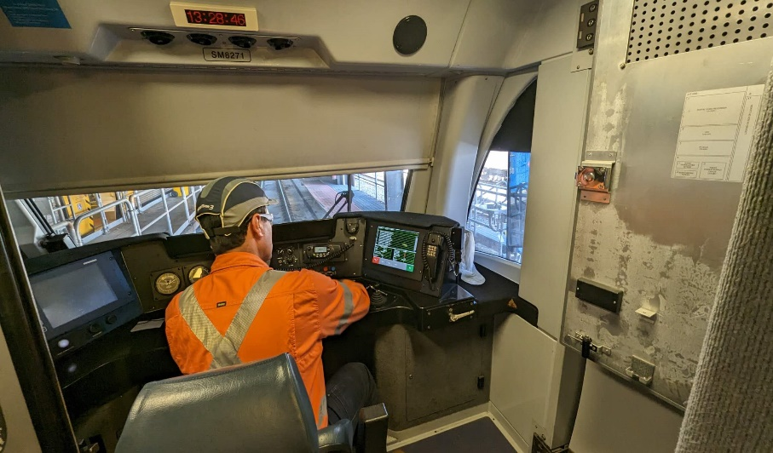
ENGINEERING
SERVICES
Compliance Assurance
Government Compliance
Customer Specifications
Testing
Engineering Governance
Design Validation
13

Slide 14
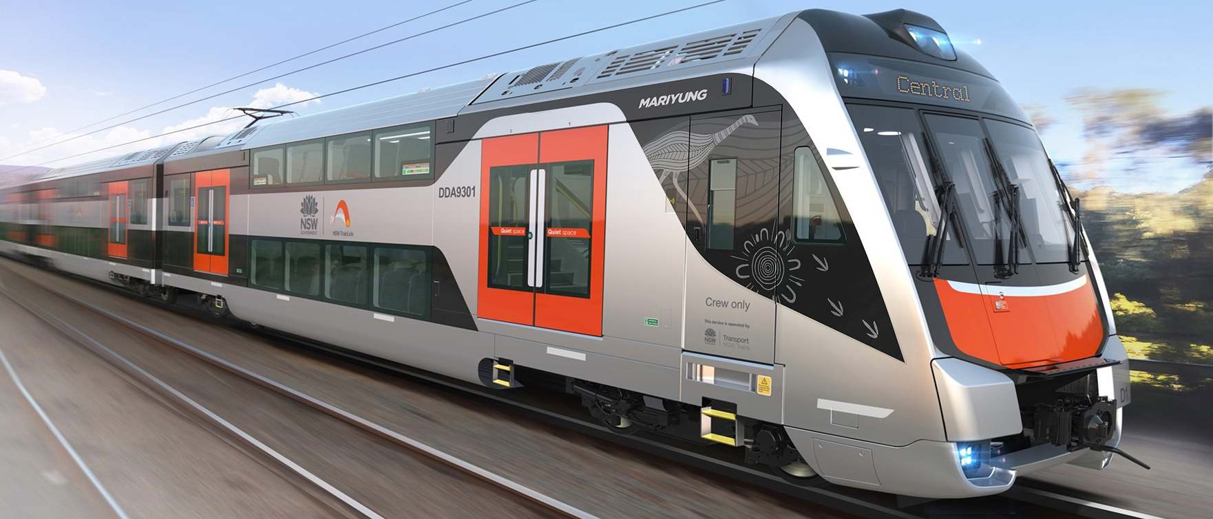
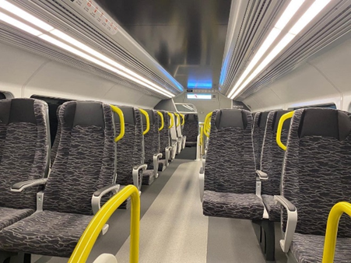
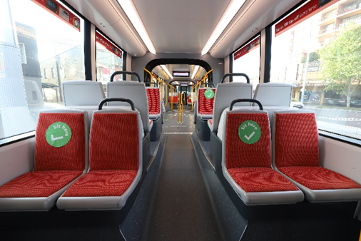
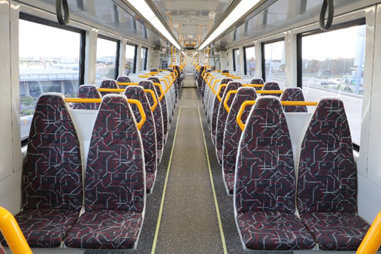
Seats
14

Slide 15
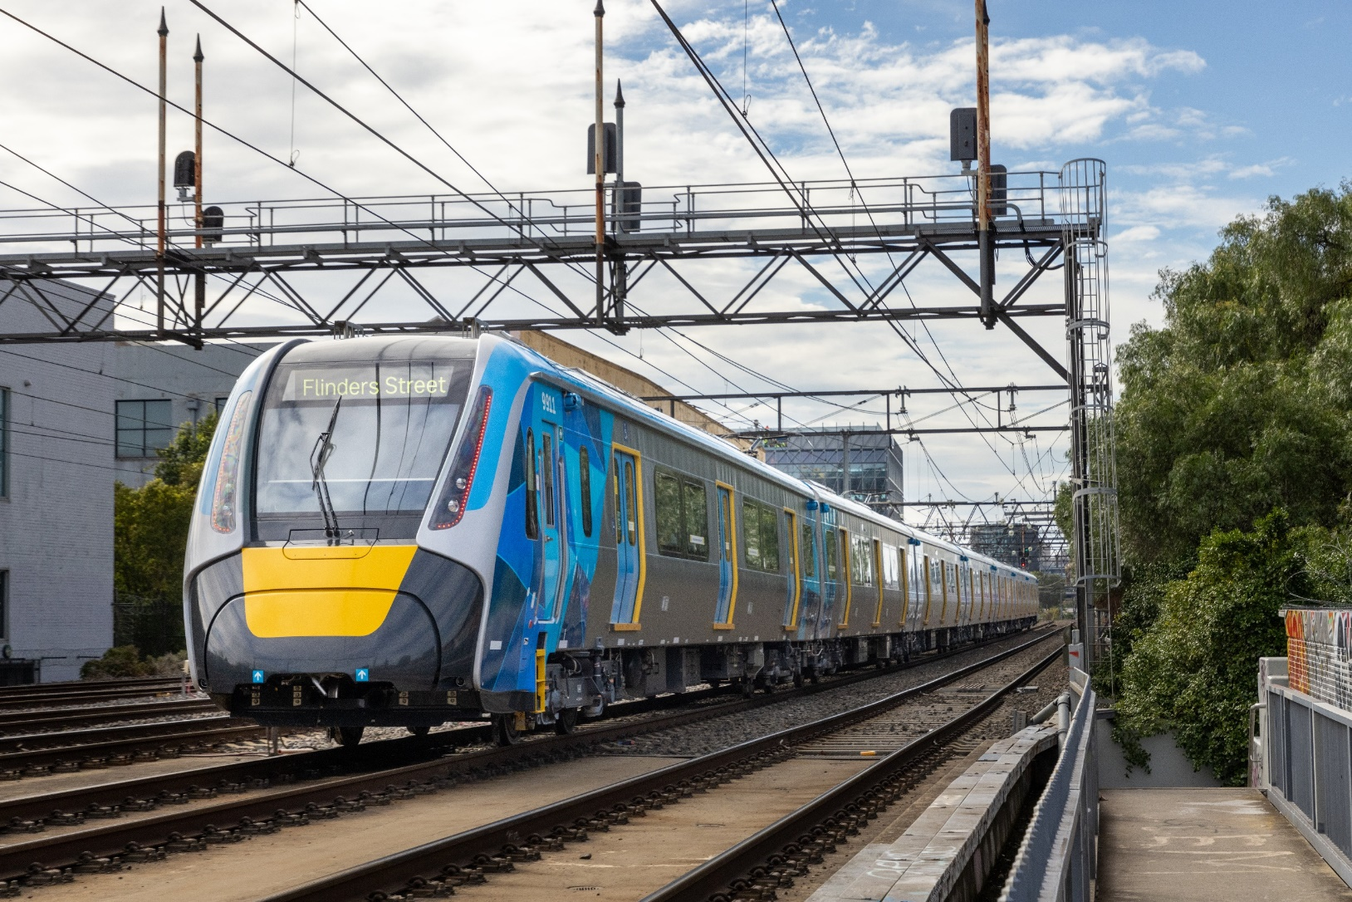
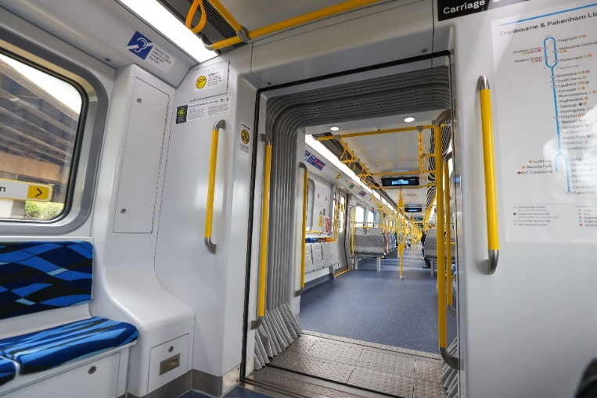
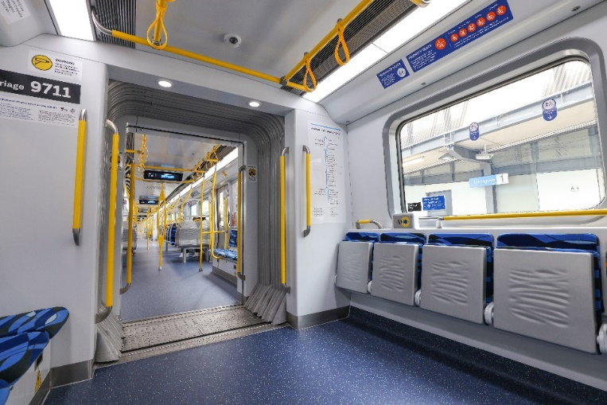
GANGWAY
SYSTEM
15

Slide 16
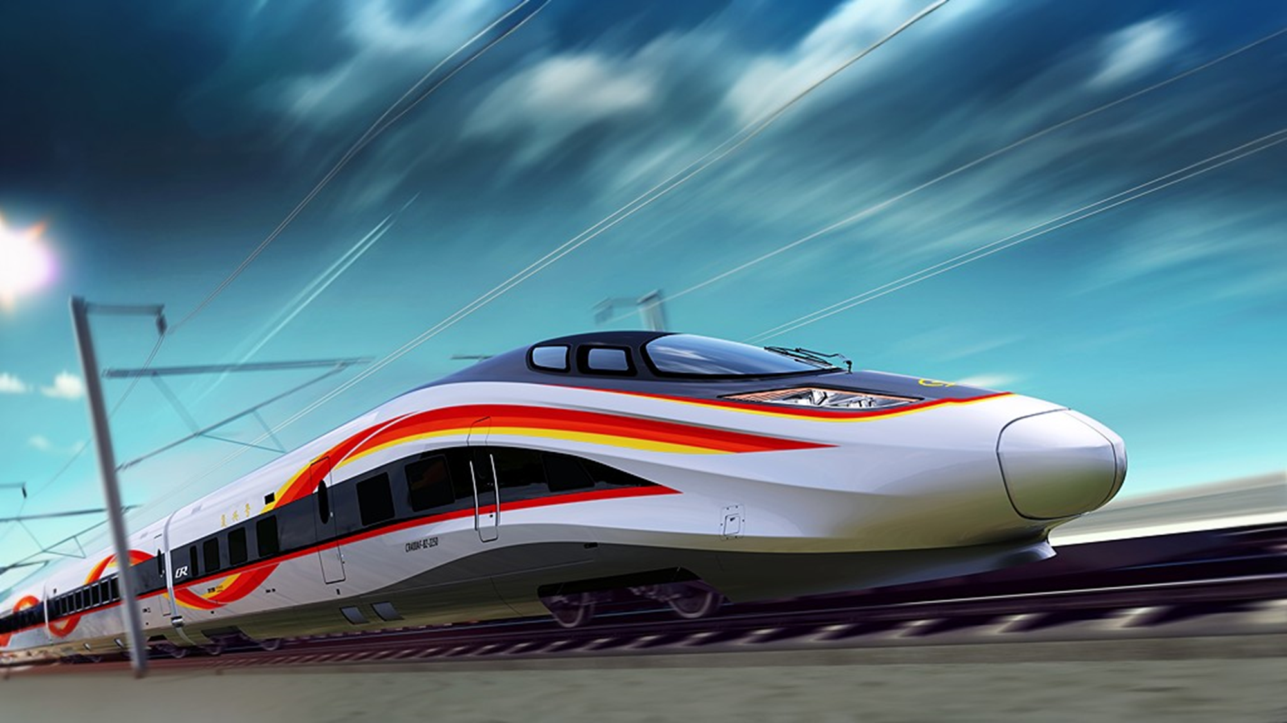

CONTACT US
Office Address: Level 2, 32 Walker St, North Sydney, NSW 2060
EMAIL: K.McCarthy@jetransit.com.au
MOBILE: +61 417 453 867

